Slide 1
24 Hour timer Circuit
By :- Rishabh Maurya (tu1f1920006)
Kshitij kadam (tu1f1920008)
Project guide :-
Prof. varsha pande

Slide 2
contents
ABSTRACT
PROBLEM STATEMENT & PROPOSED SYSTEM
BLOCK DIAGRAM
CIRCUIT DIAGRAM
IMPLEMENTD CIRCUIT
LIST OF COMPONENTS
COMPONENTS COMPARISON
COMPONENTS DESCRIPTION
WORKING
ADVANTADGES
DRAWBACK
FUTURE SCOPE

Slide 3
Abstract
This project involves the design and development of the circuit which is capable of switching off the device connected at the output of the circuit after a certain delay is passed. Whenever the device is not used or the purpose of the device have been fulfilled and yet it is consuming power, to stop the consumption of the power this circuit can come in handy. The delay of the circuit is generated by an in built oscillator and the output is taken to the relay. The circuit is assembled on a general purpose PCB.

Slide 4
Problem statement and proposed system :-
In today’s modern world where technology has been one of our basic need & this technology is driven by ‘electricity’. Every appliance or device which we use runs on electricity. But, we also need to save this electricity which is often neglected. For example: If the street lamp remains ‘ON’ during daytime, it leads to wastage of electricity in large amount. So, there was a need to design or implement the circuit which can automatically turn ‘OFF’ the street lamp, & perform such type of small functions which will help us to save a lot of electricity

Slide 5
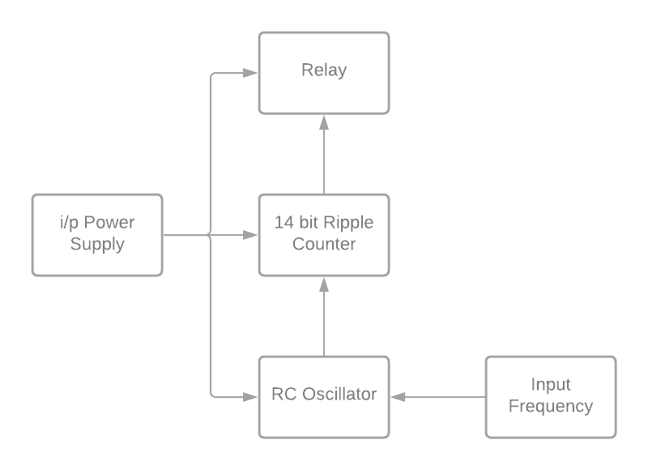
Block diagram :-
Power Supply
Input Frequency
RC Oscillator
14 Bit Ripple Counter
Relay

Slide 6
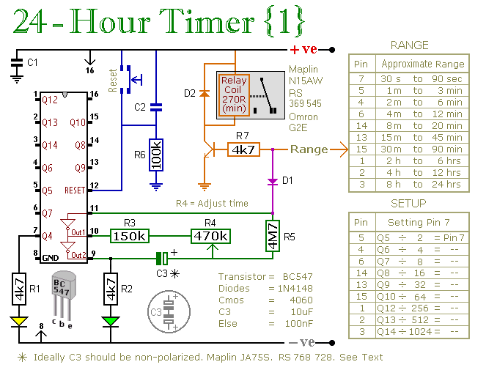
Circuit Diagram :-

Slide 7
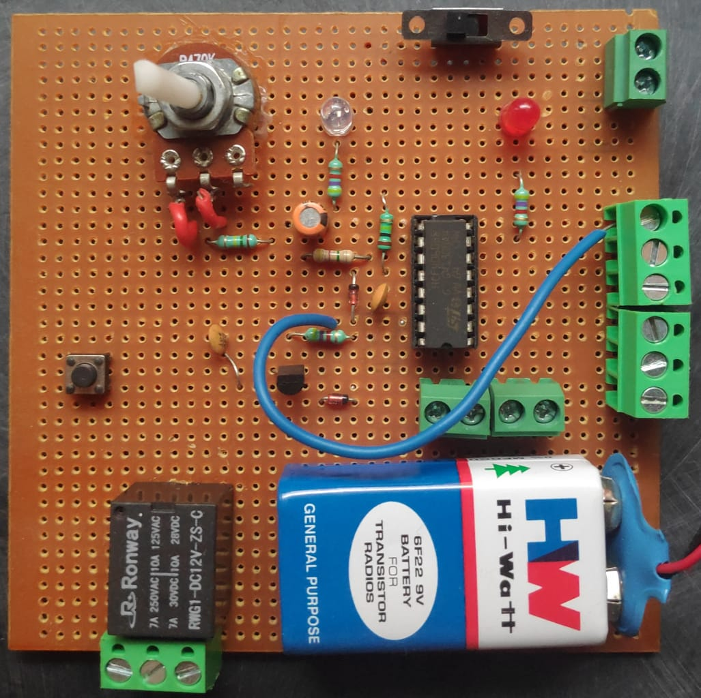
Implemented circuit

Slide 8
Component list :-
Sr. No | Component | Value
1. | Resistor | 4.7MΩ, 4.7kΩ x 3, 150kΩ , 100kΩ
2. | Potentiometer | 470kΩ
3. | Capacitor | 100nf x 2, 10uf Electrolytic
4. | Transistor | BC 547
5. | Push Button | 4 terminals
6. | IC | 4060
7. | Relay | 12 V
8. | Zener Diode | 1N4148 x 2
9. | Power Supply | 9V, DC
10. | LEDs | 2

Slide 9
COMPONENTS COMPARISON
IC 4020 | IC 4040 | IC 4060
14 bit ripple counter Maximum delay up to 2hrs Doesn't have an in built oscillator Need an external clock to start the counting. | 12 bit ripple binary counter Maximum delay up to 24hrs and cannot be increased by changing the values. Doesn't have an in built oscillator Need an external clock to start the counting. | 14 bit ripple counter Maximum delay up to 24hrs and can be increased by changing the values. Does have an in built oscillator No need an external clock to start the counting.

Slide 10
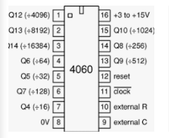
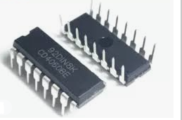
Components Description
IC 4060
The IC4060 is a 14-stage ripple-carry binary counter and has a oscillator with three oscillator terminals (CLK, REXT and CEXT), ten buffered outputs (Q3 to Q9 and Q11 to Q13) and an overriding asynchronous master reset input (MR).
The oscillator configuration allows design of either RC or crystal oscillator circuits. The oscillator may be replaced by an external clock signal at input CLK. The counter advances on the negative going transition of RS. A HIGH level on MR resets the counter (Q3 to Q9 and Q11 to Q13 = LOW), independent of other input conditions.
It operates over a recommended VDD power supply range of 3 V to 15 V referenced to VSS (usually ground). Unused inputs must be connected to VDD, or VSS.

Slide 11
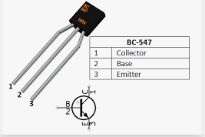
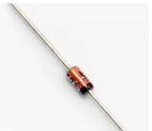
Transistor BC547
Transistor BC547 is a NPN transistor, the role of this transistor in our circuit, It is acting as pathway between the relay and rest of the circuit.
(Closed switch)
Zener diode 1N4148
It can be used to block voltage spikes to protect electronic components from overheating or damage, we are using the Zener diode in two places
1. In reverse biased mode in series with the transistor to avoid unwanted switching.
2. We have connected the diode in parallel with relay to avoid damaging some nearby components

Slide 12
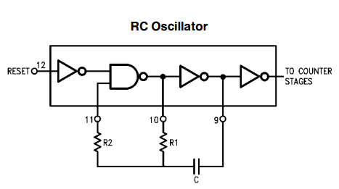
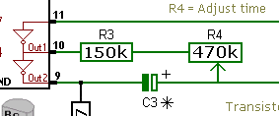
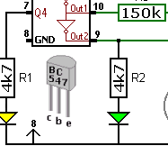
Working
The key component in our circuit is the IC 4060
As we have seen in the previous slides The IC 4060 has a oscillator with 3 input pins,
So utilizing the oscillator, we are using it as a RC oscillator configuration
And we can configure the frequency of the oscillator with the formula
F = 1 .
2.5 * (R3 + R4) * C3
And the time period of the Circuit is (This time period indicates the delay of the LED at pin 9 )
T = 1/F

Slide 13
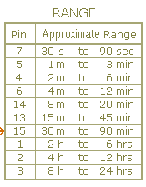
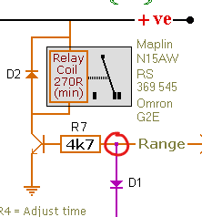
So after setting up the frequency the counter starts counting.
Since it's a 14 bit ripple counter It will count From states Q0 to Q13
Different counter stages have different delays on them,
Starting from Q4 with the smallest delay and Q13 with the largest delay
But Q0 to Q2 are not present in the circuit due to very small delay, and Q10 is not there as its delay range can be adjusted Between Q9 or Q11
From the smallest delay we have created an approximation range table, Suggesting
the delay of this pin will be in between these two ranges.
So we are connecting one of the counter stages pin to the "Intersection between the Diode D1 and Resistor R7 in the circuit"
(For example we have connected the pin 7 to the Intersection )

Slide 14
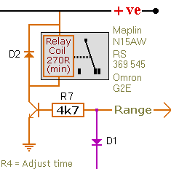
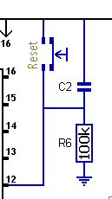
After the counter has counted till the Q4 state, It will provide a logical high o/p to pin 7, which then goes to the Transistor, then the transistor saturates, it acts as a closed switch then energises the relay.
On the other hand, pin 11 goes high, as the asynchronous counter in the IC4060 is negative edge triggered, The counting advances during the falling edge. So logical high pin will act as a continuous high level trigerring , causing the counter stop in its current state and counter won't advance any further.
The MR- Master reset is used to reset the all the flipflops in the IC causing the counter to start count from the beginning, The reset can be achieved by pressing the reset button in the circuit.

Slide 15
Advantages
One of the advantages of the circuit and it's main purpose is, it can be used to save electricity in many scenarios, by automatically turning off the device such as street lights, advertisement billboards.
Circuit is compact and portable.
DRAWBACK
Small drawback of the circuit is, setting up the time, as it needs to be calculated and needs the adjustment of the potentiometer to get proper o/p delay
FUTURE SCOPE
We can use the similar circuit and adjust the values such that it provides delay up to 48Hr, then use it with the existing circuit in series connection to obtain automatic on and off at the same time.

Slide 16
References
IC 4060 Datasheet
Datasheet 1
Datasheet 2
Zener diode 1N4148
Zener datasheet
Transistor BC547
BC547 Datasheet
Demonstration Video
Video

Slide 17
Thank You

